Slide 1
Spatiotemporal Analysis of Urban Noise Data
Prof – Fabio Miranda
- By
Sasanka Mouli Veleti
Ashwin Srivatsa
Sidharth Veluvolu

Slide 2
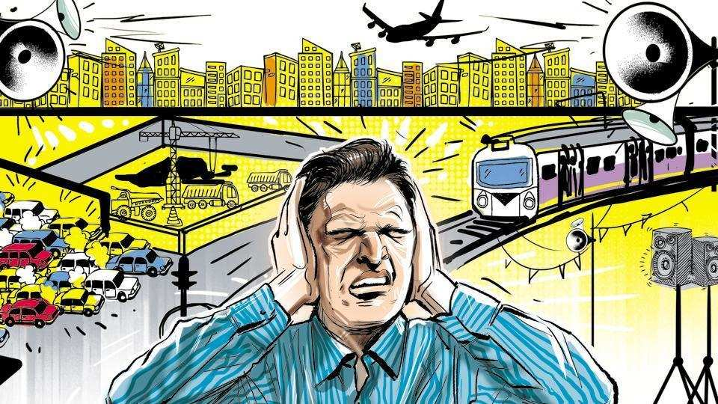
Introduction :
Noise Pollution is a grievous problem which needs to be tackled, as it’s a growing concern for many urban residents.
Noise is not only inconvenient and annoying, but it has also been proven to be a health hazard, many have reported that they suffered with behavioral and emotional consequences, such as difficulty in sleeping, relaxing and feeling annoyed, angry or upset.
Sound event detection is a popular technique to identify the sound events in the noise e.g., “dog barking, engine exhaust noise” etc.

Slide 3
Proposal:
We propose to build a tool which visualizes the spatiotemporal and mismatch values of the dataset.
Using Multi Label Classification Machine Learning Algorithms we will classify the audio files into various categorical sounds.
Visualize the points where the mismatches of testing and machine predicted data occur based on the results of the Machine Learning model.
We will dwell into understanding the mismatches which occur between the annotated and machine predicted data and analyze the causes behind it.

Slide 4
Data Description:
In order to build a system which would visualize the various sound points in and around a particular geographical location and also allow us to analyze the mismatches between the test and machine data, we need to have a dataset which has a diverse distribution of labeled sounds with spatial and temporal attributes.
For which we have taken a dataset containing a training subset (13538 recordings from 35 sensors), validation subset (4308 recordings from 9 sensors), and a test subset (669 recordings from 48 sensors).
Each recording has been annotated using a set of 23 “sound tags” like “engine presence, machinery presence, non-machinery-impact presence, dog-barking-whining presence, music presence etc.”
The audio was recorded from the SONYC(SONYC Urban Sound Tagging) acoustic sensor network.

Slide 5
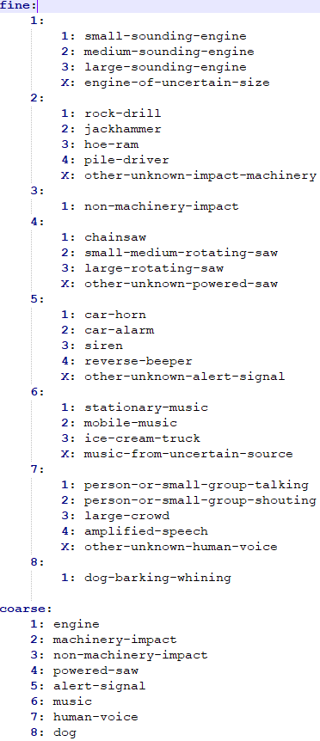
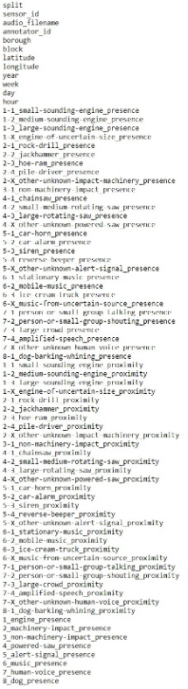
The images explains the taxonomy of sounds to classify in the dataset.

Slide 6
Implementation:
Extracting embeddings from the audio files using OpenL3.
Train the fine-level model and produce predictions
Evaluate the fine-level model output file (using frame-averaged clip predictions) on AUPRC
Evaluate the coarse-level model output file (using frame-averaged clip predictions) on AUPRC
Analysis of mismatches between the predicted and truth values
Build a system to visualize the results
Train the coarse-level model and produce predictions

Slide 7
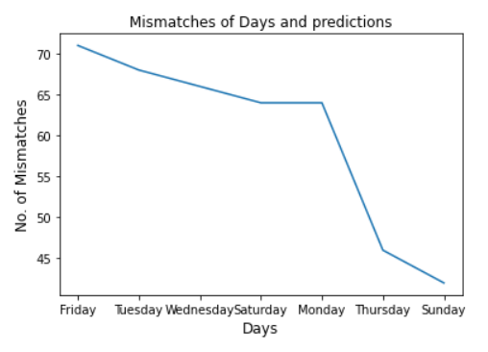
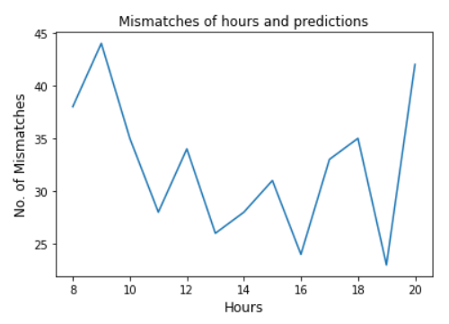

Slide 8
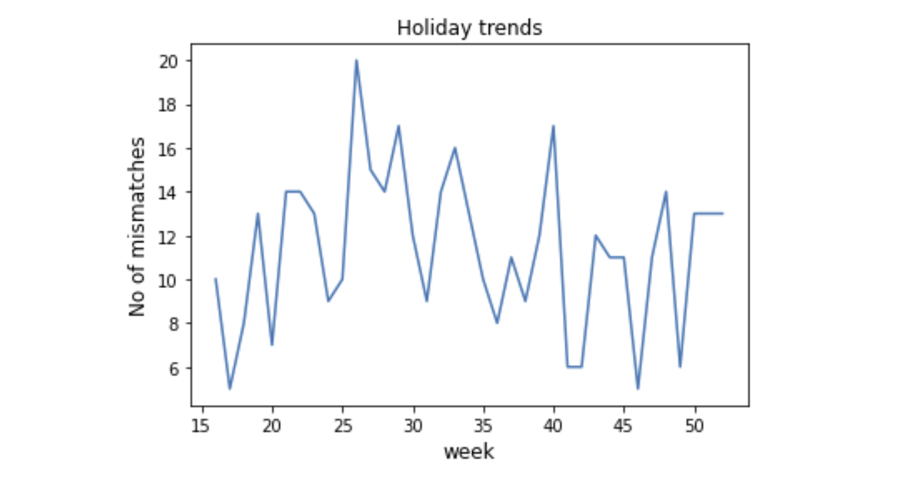
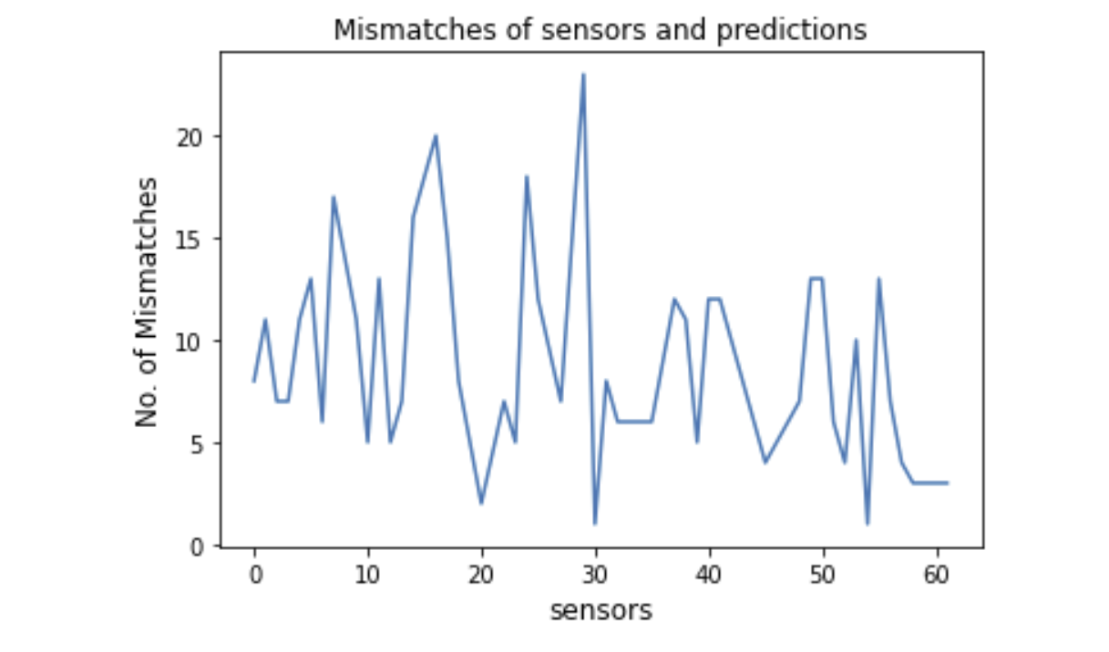
Analysis of mismatches

Slide 9
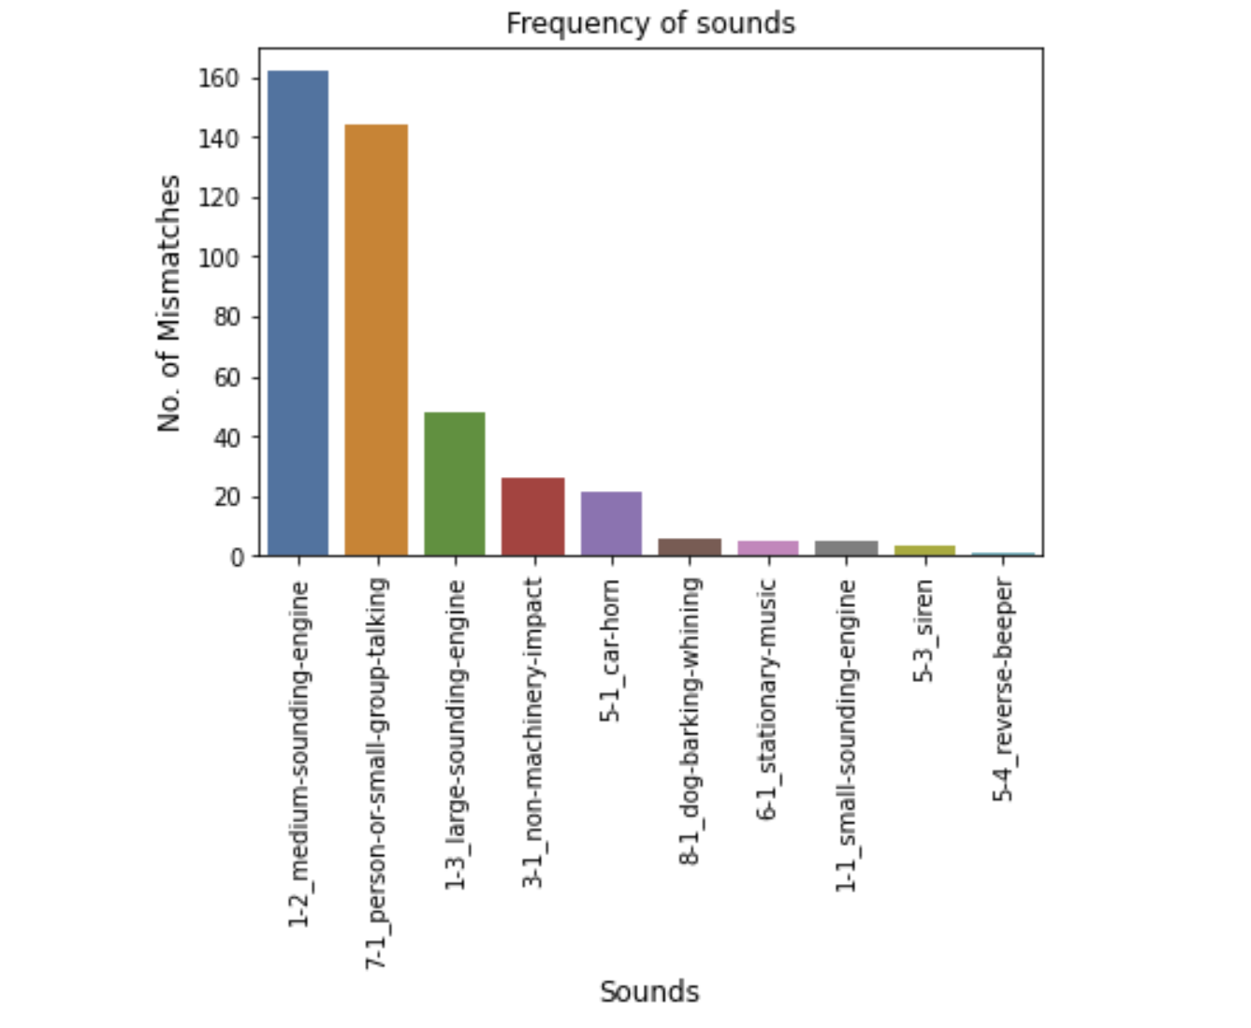
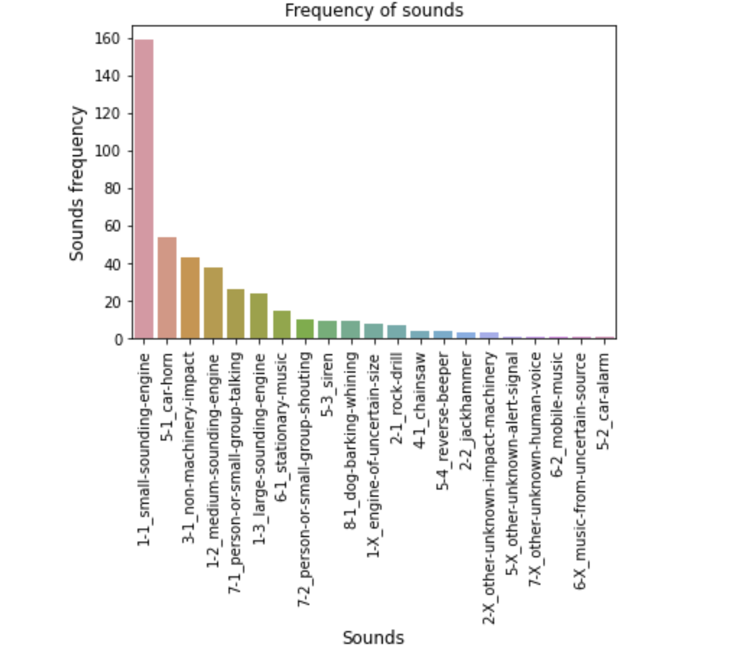
Actual vs Predicted Sounds:

Slide 10
Building the Backend System
Developed a back-end system using Flask which leverages the results of data analysis.
Built the following API’s:
/sensors – Get all the sensors data
/particular – Get the count of mismatches, matches of a particular sensor.
/sound_predicted – Get the most predicted sound at a particular region.
/mismatched_chart – Get the number of matches and mismatches and get the most frequent sound.
/mismatched_time – Get mismatches based on time.

Slide 11
Building the Frontend System
Built the frontend using Angular and d3.js with the following three components:
Map (Spatial Component) – To address and plot all the sensor points on the map.
Chart – To plot the points produced on the map based on the given conditions selected.
Temporal Component – Visualizing the results using temporal data.

Slide 12
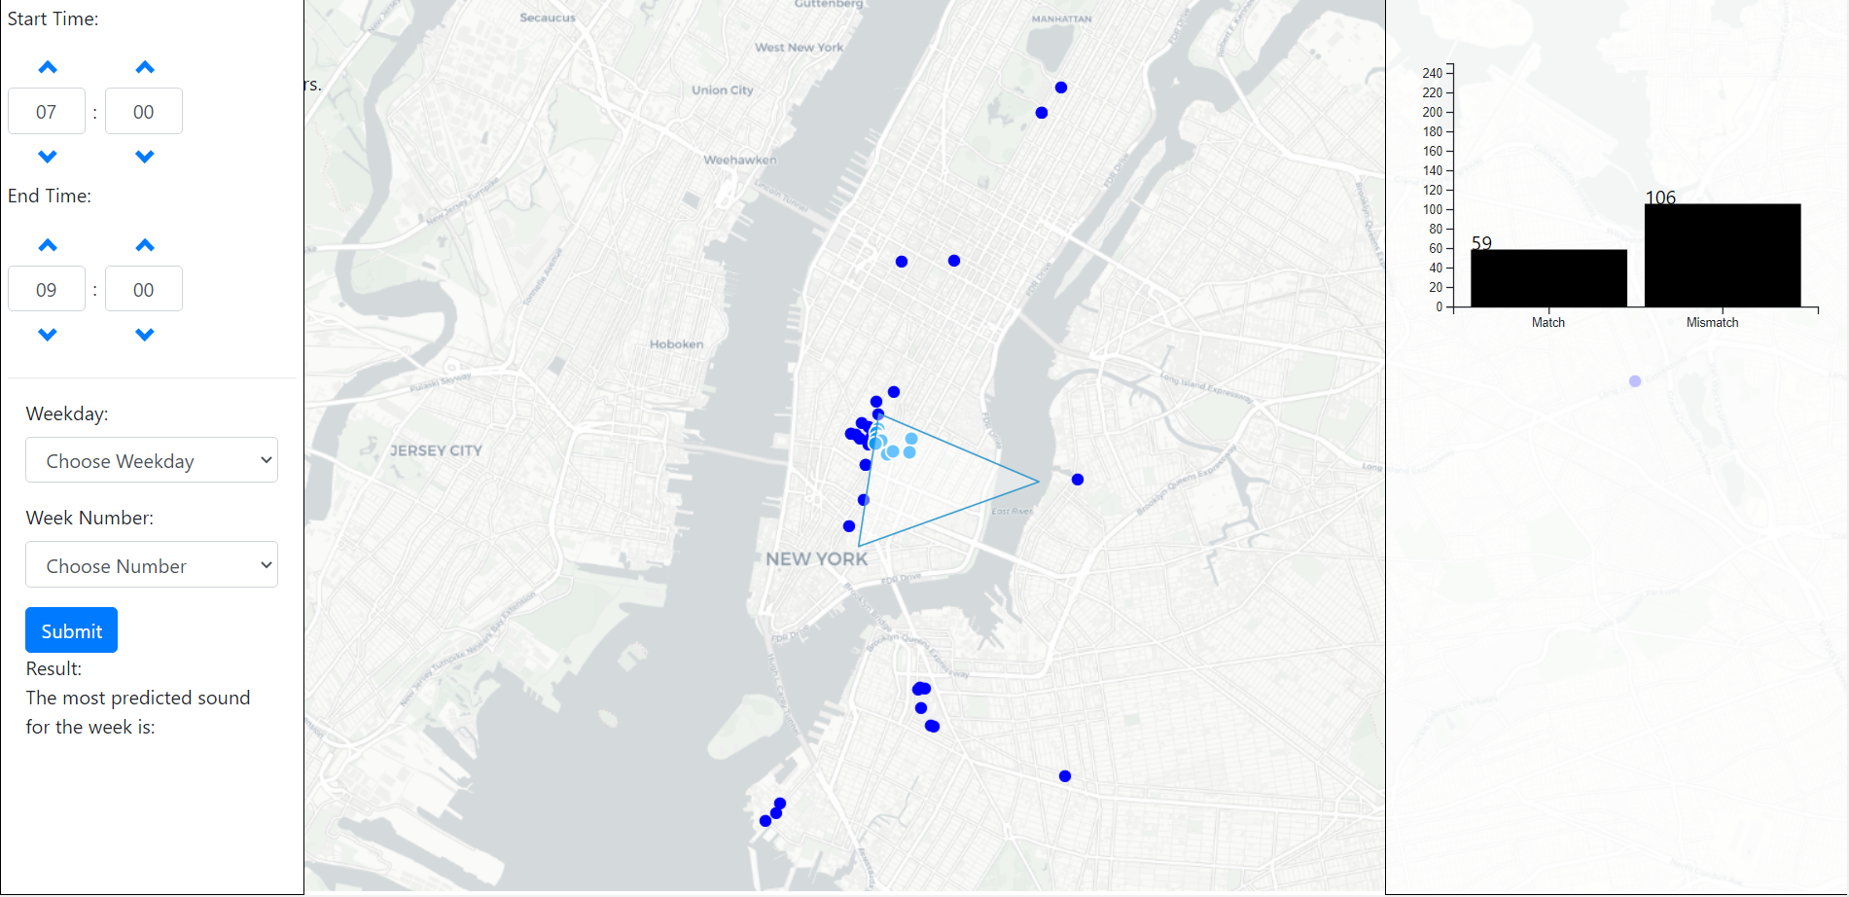
Demo of Visual System:

Slide 13
Conclusion
The model is more biased towards certain sounds in the city like medium-sounding-engine and small-group-talking.
According to the visualization the sensors present in the Greenwich Village have the most mismatches
We can also infer that as we predict sound based on fine level, the mismatches are more but if we consider the course level the amount of mismatches would decrease.
Built the front end and back-end system to visualize the spatiotemporal and mismatch values of the dataset based on New York City.

Slide 14
Future Work:
We can provide insights to tweak ML models based on results in various regions and plan to remove bias towards certain sound groups in the city.
We can expand the system to major cities to predict the sounds on various dates based on the data gathered from the sensors.
We can combine data from different years and arrive at a concrete analytical trends.
We plan to improve the f1 score of the model.

Slide 15
Related works:
Mark Cartwright, Ana Elisa, Mendez Mendez1 and J. P. Bello. Sonyc urban sound tagging (sonycust): A multilabel dataset from an urban acoustic sensor network. Detection and Classification of Acoustic Scenes and Events 201, October 2019.
SONYC has developed an acoustic sensor with high quality and low production cost to monitor the noise pollution levels across the city in neighborhoods like Manhattan, Brooklyn and Queens.
The VGG models were trained on this data and the AUPRC achieved by the models are 0.62 and 0.76 which performed poorly on music and non-machinery sounds.

